Slide 1
Memristor Logic
Practical Analysis and Comparison of Memristor Based Circuits
Vijay Gami
Notes:
Good afternoon everyone, thank you for coming.
My name is Vijay, and this presentation is about memristor based logic circuits.

Slide 2
Outline
Background and motivation
Modelling
Logic families
Example: full adder circuit
Summary
Notes:
First I'm going to start with a bit of background material, so what is a memristor and why is it important?
Then I'm going to briefly discuss the theoretical model which I chose to implement for simulations and why.
Most of my work focused on simulating various logic families in order to compare them and asses their feasibility. Unfortunately, there isn't enough time to cover all of them, so instead I’ll focus on the one which was most successful with the model I chose to use. Ill try to explain the fundamental concept, and then explain an adder circuit which was developed.
And finally, the summary.

Slide 3
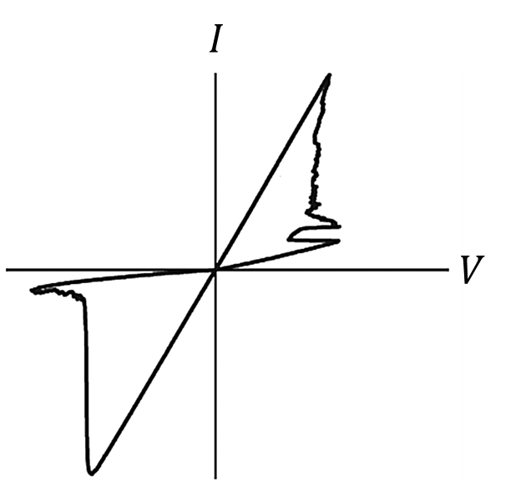

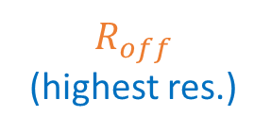
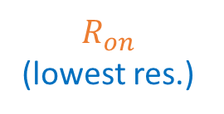


What is a Memristor?
Memory Resistor
Two terminal passive device
Predicted by Professor Leon Chua in 1971
Popularised by HP Labs $TiO_{2}$ device in 2008
$R_{off}$
(highest res.)
$$Resistance Increace$$
$R_{on}$
(lowest res.)
$$Current$$
Notes:
So, first of all what is a memristor?
Well, the name is short for memory resistor, and this pretty much summarises operation. It refers to a two terminal passive device whose instantaneous resistance depends on the history of the current which has passed through the device in the past.
Initially it was predicted by professor Lean Chua back in the early 1970’s based on symmetry,. He proved it to be the fourth fundamental component in the sense that it cannot be synthesised by any combination of resistance, capacitance or inductance.
This field has regained popularity only recently after HP revealed their $TiO_{2}$ device in 2008.
This is the standard circuit symbol, and the black thick line indicates the polarity. When current flows into the black bar (from left to right), the resistance increases.
This is the IV curve of HP’s device. it has the standard pinched hysteresis shape which is characteristic of any memristor. For binary digital applications, only the highest and lowest resistances are of interest, and these are called Roff and Ron.

Slide 4

Motivation
Advancements in computing by miniaturisation
Transistor scaling reaching fundamental limits
Beyond $10nm$is uncertain (cost effectiveness)
Memristors can be smaller
Higher packing densities
Notes:
So why are these devices useful?
Advancements in computing have transformed nearly everyone's lives for the better. Its hard to imagine a life without smart phones and mobile communications. one of the driving factors behind this is the steady miniaturization of transistors, but the problem is transistor scaling is reaching fundamental limits. scaling beyond 10nm is uncertain in terms of cost effectiveness. At these sizes all sorts of problems occur, like leakage current, and sensitivity of parameters to fabrication accuracy.
The good news is memristors can be much smaller and have higher packing densities. They can also compatible with the CMOS process and can be produced above the CMOS layer which means circuits which are a hybrid of memristors and transistors can achieve smaller area usage.
The memristors are actually constructed in-between the overlapping crossbars as can be seen from the top layer of this figure.

Slide 5
Modelling
Non-linear state space
State equation: 1 state variable with physical meaning
Output equation: IV relationship
Modified version of VTEAM model in PSpice
Computationally efficient
Sufficiently accurate
Flexible and can fit many types of device
Explicit voltage threshold
Notes:
The first part of my project involved selecting a mathematical model for implementation in PSpice.
There are actually a lot of proposed models to chose from, but they all have the same general structure. They are all in state space form and most are non-linear.
This means they consist of 2 equations: the state equation and the output equation. The output equation describes the relationship between current and voltage for a given state, and the state equation describes the state dynamics with voltage or current.
There is usually only one state variable and this is chosen to have some physical meaning. For example, the figure shows the simplest model which describes the memristor as two regions with different resistivity. The state variable here represents the length of the doped region and this changes length changes with applied voltage or current.
I chose to implement a modified version of the VTEAM model because of the advantages it offers. It is efficient, sufficiently accurate
It also has an explicit voltage threshold which somewhat represents observations of many practical devices including HPs titanium dioxide one.

Slide 6

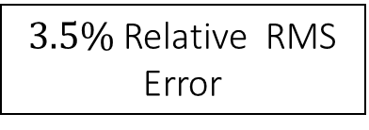
Model Fitting – $TiO_{2}$Device
$3.5\%$Relative RMS Error
Notes:
For a model to be useful, it needs to be fitted to experimental data. This IV curve summarises the results of the fitting to a titanium dioxide device.
The relative error is 3.5% which doesn’t sound ideal, but it is close to what most models achieve, and it is good enough for the purpose of this project.

Slide 7
Logic Families:
3 most promising:
1) Material Implication
2) MAGIC – Memristor Aided Logic
3) MRL – Memristor Ratio Logic
Notes:
There are three memristor based logic families which are most promising: Material implication, Memristor Aided Logic, and Memristor Ratio Logic.
The first two were unsuccessful with the fitted model, but they are still feasible to some extent. They just require memristors with different properties.
I'm only going to talk about MRL since this one worked with the fitted model.

Slide 8












MRL Operation
$$AND Truth Table$$
$AND$ Gate
$R_{on}$ $(low resistance)$
$$v_{in 1}$$
$$≈0$$
$$v_{in 2}$$
$$v_{out}$$
$$R_{off} (high resistance)$$
$OR$ Gate
$$v_{in 1}$$
$$v_{out}$$
$$v_{in 2}$$
Notes:
This slide shows a 2 input AND gate the corresponding truth table. Operation can be explained by considering all the input cases. Firstly, when both inputs are low. This is assuming there is no load on the output.
When both inputs are 1, no currents flow and the output is 1.
The remaining two cases are symmetrical, so only one needs to be described. When one input is high, and the other is low, the current flows from high to low. In this case, the polarity of the memristors is such that the top one switches to Ron (low), and the bottom one switches to Ron. Based on the potential divider formed, the output is then almost zero.
The or gate operates in the similar way, except the polarity of the memristors is opposite so the switching is also opposite.

Slide 9



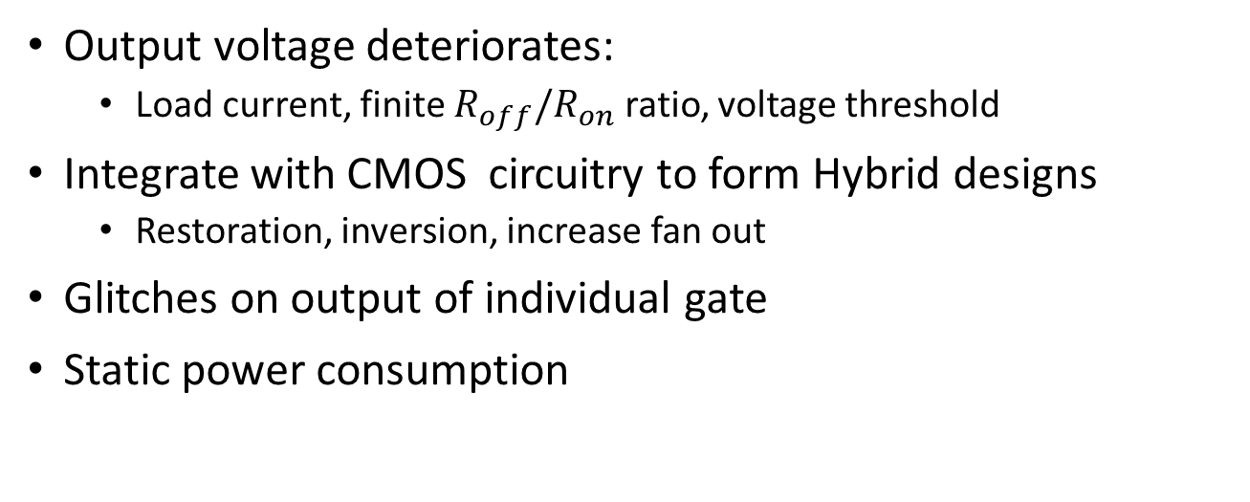











MRL Limitations
Output voltage deteriorates:
Load current, finite $R_{off}/R_{on}$ ratio, voltage threshold
Integrate with CMOS circuitry to form Hybrid designs
Restoration, inversion, increase fan out
Glitches on output of individual gate
Static power consumption
$NAND$ Gate
$NOR$ Gate
$$Vdd$$
$$Vdd$$
$$R_{1}$$
$$v_{in 1}$$
$$v_{in 1}$$
$$v_{out}$$
$$v_{out}$$
$$v_{in 2}$$
$$v_{in 2}$$
$$R_{2}$$
$$Vss$$
$$Vss$$
Notes:
What I just described is ideal operation. in reality, there will be some currents drawn from the outputs due to subsequent gates. Also the Roff to Ron ratio is not infinite, and voltage thresholds for switching can prevent complete switching from Roff to Ron. These all work to deteriorate the output voltage.
Another limitation is that memristors alone cannot perform inversion.
These two problems can be solved by integrating CMOS transistors with the memristors. The transistors can be used for signal restoration or inversion whenever necessary. They also increase the fan out of the gate.
This integration is possible since the technologies can be compatible in terms of voltage levels and the production process.
Ideally, a memristor with large ratio and no switching threshold is desired so the amount of CMOS circuitry necessary is small.
There are some other issues which are not so easy to solve. For example, these gates are prone to glitches on the output since it takes non-zero time for memristors to switch state.
Also, they consume static power for some input combinations.

Slide 10







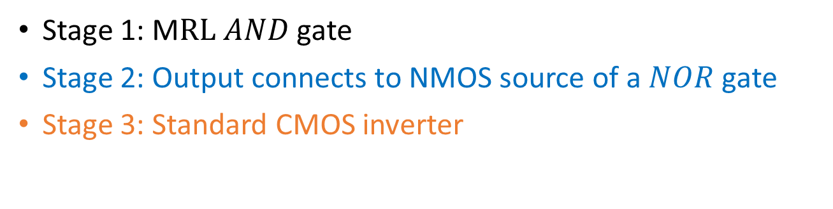

Hybrid XOR gate
Stage 1: M$RL AND$gate
Stage 2: Output connects to NMOS source of a $NOR$gate
Stage 3: Standard CMOS inverter
$$Vdd$$
$$v_{in 1}$$
$$v_{in 2}$$
$$v_{out}$$
$$v_{in 1}$$
$$v_{in 1}$$
$$v_{in 2}$$
$$v_{in 2}$$
Notes:
This shows a hybrid XOR gate. its operation can be explained by breaking the circuit down into three stages. First the memristors perform AND operation. the output of this is connected to the NMOS source of the following NOR gate. These two together result in XNOR operation because when the inputs are both high, the output is also high because of the high NMOS source.
The final stage is a standard CMOS inverter which produces the XOR and also restores the signal.
One issue with this circuit is that it requires the n-type mosfet threshold to be lower than the p-type. This is because when both inputs are high, the output of the second stage is actually vdd minus the n-type threshold. If the transistors have the exact same threshold, then the operation of the last stage is not robust.

Slide 11







Hybrid Full Adder
Hybrid: 4 memristors and 18 MOSFETs
Standard CMOS: 28 MOSFETs
21% reduction in device count
$$Vdd$$
$$v_{in 1}$$
$$v_{in 3}$$
$$v_{in 2}$$
$$SUM$$
CARRY
$$v_{in 1}$$
$$v_{in 2}$$
Notes:
This figure shows a hybrid full adder which shows a full adder made up of 18 transistors and 4 Mosfets. In comparison, a standard CM|OS adder requires 28 Mosfets, so there's a 21% reduction in are not even considering the fact that memristors are smaller than transistors.
It is made up of 2 XOR gates which generate the sum output. These are shown by the blue and orange parts. The green transistors form an OR gate and they generate the carry. They could actually all be replaced with 2 memristors, but this doesn’t work with the model used since the voltage deterioration is too significant for the fitted model used.

Slide 12
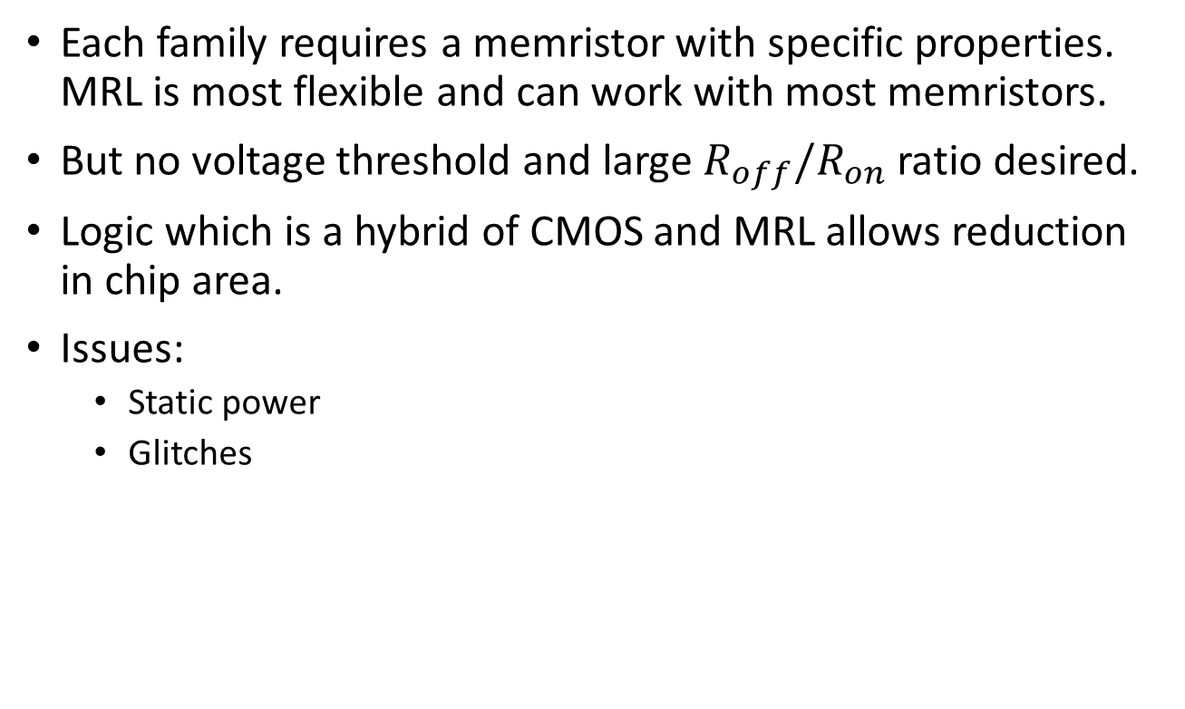
Summary
Each family requires a memristor with specific properties. MRL is most flexible and can work with most memristors.
But no voltage threshold and large ${R_{off}/R}_{on}$ ratio desired.
Logic which is a hybrid of CMOS and MRL allows reduction in chip area.
Issues:
Static power
Glitches

Slide 13
Questions

Slide 14
PSpice Implementation:

Slide 15

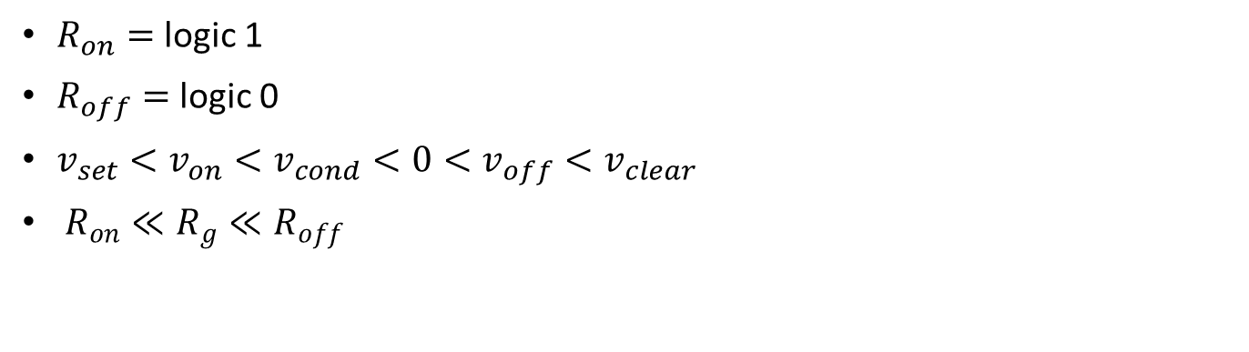

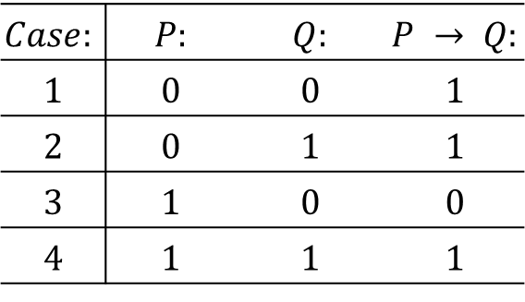






Material Implication Logic:
|$v_{cond}$|
|$v_{set}$ |
$$Case:$$ | $$P:$$ | $$Q:$$ | $$P → Q:$$
$$1$$ | $$0$$ | $$0$$ | $$1$$
$$2$$ | $$0$$ | $$1$$ | $$1$$
$$3$$ | $$1$$ | $$0$$ | $$0$$
$$4$$ | $$1$$ | $$1$$ | $$1$$
$$v_{p}$$
$$v_{q}$$
$$p$$
$$q$$
$$v_{g}$$
$$R_{g}$$
$R_{on}=$ logic 1
$R_{off}=$ logic 0
$v_{set}<v_{on}<v_{cond}<0<v_{off}<v_{clear}$
$R_{on}≪R_{g}≪R_{off}$

Slide 16
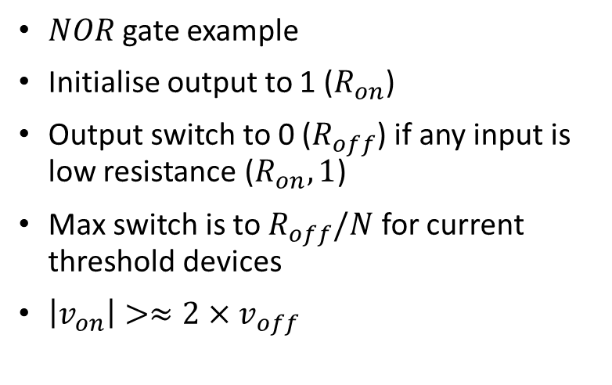
MAGIC:
$NOR$gate example
Initialise output to 1 ($R_{on}$)
Output switch to 0 ($R_{off}$) if any input is low resistance ($R_{on}, 1$)
Max switch is to $R_{off}/N$ for current threshold devices
$\left|v_{on}\right|>≈2×v_{off}$

Slide 17
















XOR robustness detail:
$$5V$$
$$5V$$
$$5V$$
$$5V$$
$$Off$$
$$R_{LARGE}$$
$$5V$$
$$Flip$$
$$v_{t}$$
$5$-$v_{t}$
$$5V$$
$$5V$$
$$R_{LARGE}$$
$$5V$$
$$5V$$
$$5V$$
Notes:
Gate source voltage is just above vt.

